Slide 1
SDEV2501
Day 02 - Data Science Lifecycle & Terms

Slide 2
Today’s objective
Identify stages in a typical data science lifecycle

Slide 3
Agenda
Phases of the Data Science Lifecycle
Data Types

Slide 4
Review

Slide 5
Housekeeping reminders
Attend class & ask questions!
Request extensions 10 days in advance where possible.
Access NAIT resources to support your learning & wellbeing.

Slide 6
Day 1 check-out ticket feedback
What are we looking forward to?
What are we nervous about?
Questions & requests

Slide 7
Intro to Data Science
What is data science?
What is data analytics?
What is data visualization?

Slide 8
Data Science Lifecycle

Slide 9
Data Analysis vs BI vs Data Science
Same data (& tools): different jobs.
  Data Analysis seeks to answer specific questions.
  Business Intelligence monitors performance
  Data Science builds predictive models

Slide 10
Data Analysis
Turning a business problem into an answerable question
  Clarity > cleverness
Systemic use of available data to answer a question.
  Without data: it’s philosophical.
These data should support decision-making.
  Without a decision, it’s just nice-to-know trivia.

Slide 11
What is Data Analytics?
Data analytics is the process of examining, cleaning, transforming, and interpreting data to discover useful information, identify patterns, and support decision-making.
For example, suppose a college has data about student attendance, grades, and course completion. Data analytics could be used to answer questions such as:
  What percentage of students successfully complete each course?
  Is attendance related to academic performance?
  Which courses have the highest failure rates?
  Are student results improving from year to year?
  Which students may be at risk of dropping out?

Slide 12
Main Types of Data Analytics
There are four commonly recognized types of Data Analytics:
Type | Main question | Example
Descriptive Analytics | What happened? | 15% of students failed the course last semester.
Diagnostic Analytics | Why did it happen? | Students with low attendance had higher failure rates.
Predictive Analytics | What is likely to happen? | Predict which students are at risk of failing.
Prescriptive Analytics | What should we do? | Recommend additional tutoring for particular students.

Slide 13
Data Visualization
Data visualization is the process of representing data graphically using charts, graphs, maps, dashboards, and other visual elements so that information is easier to understand.
Instead of looking at a large table of numbers, we can visualize the data to quickly identify patterns, trends, relationships, comparisons, and unusual values.

Slide 14
Common types of data visualization
Different visualizations are useful for different purposes:
Visualization | Useful for
Bar chart | Comparing different categories
Line chart | Showing changes or trends over time
Pie chart | Showing proportions of a whole
Histogram | Showing the distribution of numerical data
Scatter plot | Showing relationships between two variables
Map | Showing geographical patterns

Slide 15
What is Data Science?
Data science is the scrutinizing and processing of raw data to extract useful insights, solve problems, and support decision-making.
  It is multidisciplinary, combining statistics, mathematics, programming, and domain knowledge to analyze large amounts of data.

Slide 16
What does a data scientist do?
A data scientist typically:
  Collects data from various sources.
  Cleans and organizes the data.
  Analyzes the data to identify patterns and trends.
  Builds predictive models using machine learning.
  Communicates findings through reports and visualizations.

Slide 17
Key components of data science
The main disciplines involved in data Science are:
  Mathematics and Statistics – Understanding data and making predictions.
  Programming – Using languages like Python, R, or SQL to work with data.
  Machine Learning – Creating models that learn from data and make predictions.
  Data Visualization – Presenting data using charts and graphs with tools like Tableau, Power BI, or Matplotlib.
  Big Data Technologies – Managing large datasets using tools such as Hadoop and Spark.

Slide 18
Applications of data science
Data science is used in many industries, including:
  Healthcare: Predicting diseases and improving patient care.
  Finance: Detecting fraud and assessing credit risk.
  E-commerce: Recommending products to customers.
  Marketing: Understanding customer behavior and improving campaigns.
  Transportation: Optimizing routes and enabling self-driving technologies.

Slide 19
Data Science Lifecycle

Slide 20
Stages of the Data Analysis Lifecycle
Define the question
Collect & validate data
Analyze
Interpret & communicate
Notes:
Ask / Define the question
Clarify the problem, goal, stakeholder need, or decision to support.
Collect / Acquire data
Identify, gather, or access relevant data sources.
Prepare / Clean data
Fix missing values, inconsistent labels, formatting issues, duplicates, and data quality problems.
Explore / Analyze data
Summarize, visualize, calculate statistics, and look for patterns or relationships.
Interpret / Communicate findings
Explain what the results mean in context, including limitations.
Act / Decide / Implement
Use the findings to make a decision, recommendation, change, or next step.
Evaluate / Iterate
Check whether the result answered the question and loop back if new questions, data issues, or limitations appear.

Slide 21
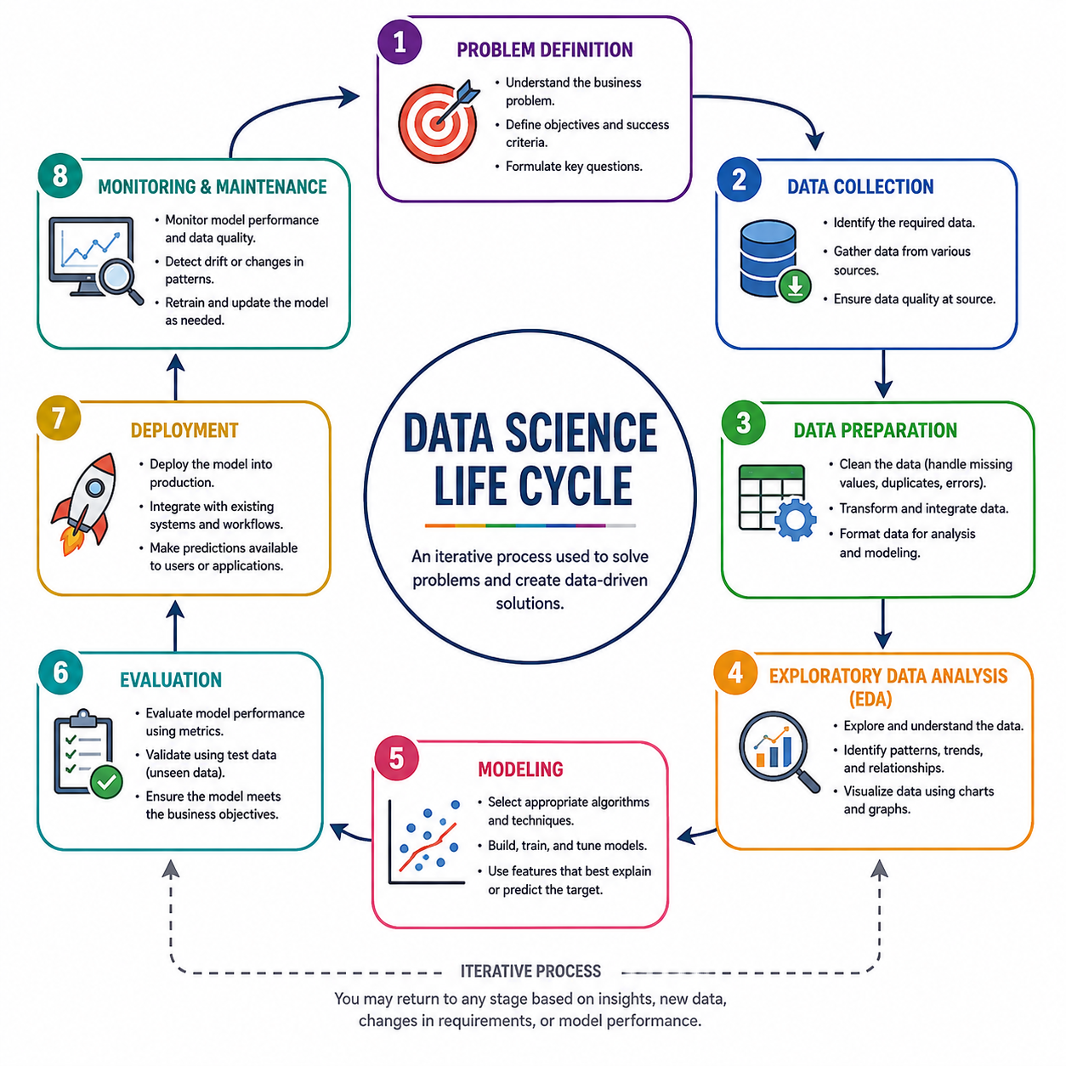
Stages of the Data Science Lifecycle
Notes:
Ask / Define the question
Clarify the problem, goal, stakeholder need, or decision to support.
Collect / Acquire data
Identify, gather, or access relevant data sources.
Prepare / Clean data
Fix missing values, inconsistent labels, formatting issues, duplicates, and data quality problems.
Explore / Analyze data
Summarize, visualize, calculate statistics, and look for patterns or relationships.
Interpret / Communicate findings
Explain what the results mean in context, including limitations.
Act / Decide / Implement
Use the findings to make a decision, recommendation, change, or next step.
Evaluate / Iterate
Check whether the result answered the question and loop back if new questions, data issues, or limitations appear.

Slide 22
What makes a question effective?
To answer a question, it needs to be
  Measurable
  Actionable
  Aligned with goals
  Supported by available data
One good question > 5 fuzzy ones.

Slide 23
Sample Scenarios
Ambiguous scenarios:
  Sales are down.
  Users aren’t engaged.
  Customer satisfaction is low.
Let’s refine:
  What changed?
  Compared to what?
  Over what time period?
  For whom?

Slide 24
Peer Refine
Does the question:
  Have a metric?
  Support a decision?
  Match the scenario?
Refine:
  What changed?
  Compared to what?
  Over what time period?
  For whom?
Customer satisfaction is low.
Are users engaged with the app?
What’s going on with sales?
How many users visit our website?
Is employee productivity improving?
Why are customers leaving?
Are students using the learning platform?
Did the campaign perform well?
Notes:
Hint: think about audience and time periods
Sample improvements:
A
“How has average customer satisfaction score changed over the last 6 months for repeat customers compared to first-time customers?”
B
“What percentage of active users complete at least one core action per session, and has that changed since the last feature release?”
C
“How did weekly online sales revenue change after the pricing update compared to the four weeks prior?”
D
“How does the conversion rate from landing page visit to sign-up differ between paid ads and organic traffic?”
E
“How has average task completion time per employee changed since the new workflow tool was introduced?”
F
“What proportion of customers who churned in the last quarter contacted support more than twice in their final month?”
G
“What percentage of first-term students log into the platform at least once per week during the first month of classes?”
H
“How did click-through rate and sign-up rate change during the campaign compared to the previous month?”

Slide 25
Activity
What tasks happen at each phase of the life cycle?
Notes:
Sample Scenario:
"Can we predict which students are at risk of failing a course?“

Slide 26
Data Types
Categorical
Numeric
Ordinal
Notes:
Think: what can I do with these data?
Sample example:
Favourite pizza toppings (can we calculate average?)
# of slices eaten
Spiciness (does the difference between them matter?)
Restaurant type
Bill amount
Rating
Back to student example:
GPA?
Letter grade?

Slide 27
Levels of Measurement
Nominal
Labels
e.g. region, product type, browser
Ordinal
Ranked order
e.g. satisfaction level, priority
Interval
Equal spacing between values, but zero does not mean “none.”
e.g. temperature, time of day, calendar years
Ratio
“Regular” numbers with true zero.
e.g. revenue, time spent on a task, file size
Notes:
Think: how much information does this number give us?
Interval: can compare, add, subtract, but not divide/multiply.
Test:
Eye colour
Customer satisfaction (out of 5 stars)
Temp in Celsius
Temp in Kelvin
Height
Race finishing position (e.g. 3rd)
Postal code
# of siblings

Slide 28
Data Science Terminology
Population = the entire group of people, objects, or observations that we are interested in studying. e.g. all students at NAIT | Sample = A subset of the population that we actually collect data from. e.g. 500 randomly selected students
Parameter = A numerical value that describes a characteristic of an entire population. e.g. the average age of all NAIT students | Statistic = A numerical value calculated from a sample. e.g. the average age of the 500 students we surveyed.
Notes:
A parameter is a number describing a whole population (e.g., population mean), while a statistic is a number describing a sample (e.g., sample mean).
e.g.
Poll just our the class “how many hours do you spend on your phone?”
We have:
- average number of hours students IN THIS CLASS spend on their phone → population
- Average number of hours students AT NAIT spend on their phone → sample

Slide 29
Practice
Student | Program | Year | Satisfaction | Study Hours | GPA | Residence | Assignments Completed
A | Business | 1 | Very satisfied | 8 | 3.4 | Edmonton | 9
B | SDEV | 2 | Satisfied | 12 | 3.8 | Calgary | 10
C | Business | 3 | Neutral | 5 | 2.7 | Edmonton | 7
D | ITBA | 1 | Very satisfied | 10 | 3.6 | Red Deer | 9
What is the data type of each column?
What is the level of measurement?

Slide 30
Closing
Reflect: where in the lifecycle would you be most comfortable working?

Slide 31
What’s next?
How do we summarize numerical data?

